Slide 1
Computer Modeling and Simulation
Lectures 25-27

Slide 2
Monte Carlo Simulation
Monte Carlo is the gambling locale in the country of Monaco. It is the home of the famous Le Grand Casino as well as many other gambling resorts.
Monte Carlo simulation is about a concept that underlies gambling, that is, probability, hence, its association and designation with the well - known gambling region.
Gambling casinos rely on probability to ensure, over the long run, that they are profitable.
For this to happen, the odds or chance of the casino winning has to be in its favor.
This is where probability comes into play because the theory of probability provides a mathematical way to set the rules for each one of its games to make sure the odds are in its favor .
As a simulation technique, Monte Carlo simulation relies very heavily on probability

Slide 3
Monte Carlo Simulation – Coin Tossing example
Consider you have a coin which you toss four times and you want to find the probability of having 3 heads and 1 tail.
Using combinatorics, we’ll find the probability in the following way
P(3 heads) =

Slide 4
Monte Carlo Simulation – Coin Tossing example
Simulation is repeatedly performing an experiment.
In the example, being discussed, one experiment will consist of four coin tosses and then you repeatedly perform this experiment to see how many times of the total experiments, you get three heads and one tail.
The more the number of experiments is, the closer will be this probability, determined by repeated experiments (simulation), to the actual probability (determined using combinatorics).

Slide 5
Monte Carlo Simulation – Python program for Coin tossing example
from random import randint
successes = 0
attempts = 10000
for i in range(attempts):
if randint(0,1)+randint(0,1)+randint(0,1)+randint(0,1) == 3:
successes += 1
print(“No. Of attempts is”, = attempts)
print(“No. Of successes is”., = successes)

Slide 6
Monte Carlo Simulation – More difficult problems
Consider the game of war.
Description of war game. https://www.youtube.com/watch?v=yX-jOVer758
How long will the game go i.e. on average, how many rounds will a game of war contain?
The solution to this problem using combinatorics will be very difficult as we have to consider all the combinations of a cards in each deck as the entire game depends on that combination.
Using monte carlo

Slide 7
History of Monte Carlo Simulation
The Monte Carlo simulation was invented in the way we just saw in the example of cards.
The technique was first developed by Stanislaw Ulam, a mathematician who worked on the Manhattan Project.
After the war, while recovering from brain surgery, Ulam entertained himself by playing countless games of solitaire.
He became interested in plotting the outcome of each of these games in order to observe their distribution and determine the probability of winning.
After he shared his idea with John Von Neumann (the brain behind the stored program computer), the two collaborated to develop the Monte Carlo simulation.
While developing the nuclear weapons, scientists knew the behavior of one neutron, but they did not have a formula for how a system of neutrons would behave.
Although they needed to understand such behavior to construct dampers and shields for the atomic bomb, experimentation was too time consuming and dangerous.
John von Neumann and Stanislaus Ulam developed the technique of Monte Carlo simulation to solve the problem.

Slide 8
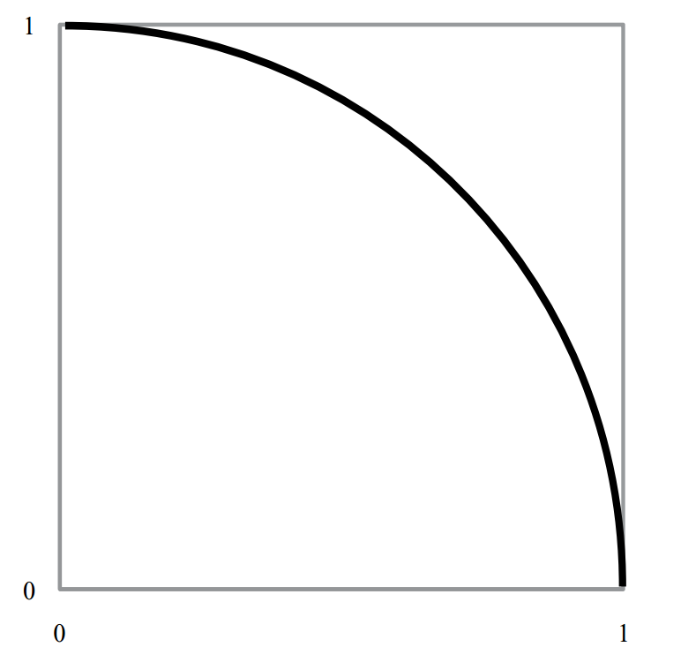
￼
Calculating value of pi using Monte Carlo simulation
Recall that the value of π is the ratio of a circle ’ s circumference to its diameter.
To calculate this value, we can set up a Monte Carlo simulation that employs a geometric representation of the circle.
Step 1: To start, draw a unit circle arc, that is, an arc of radius one circumscribed by a square as shown in the figure.

Slide 9
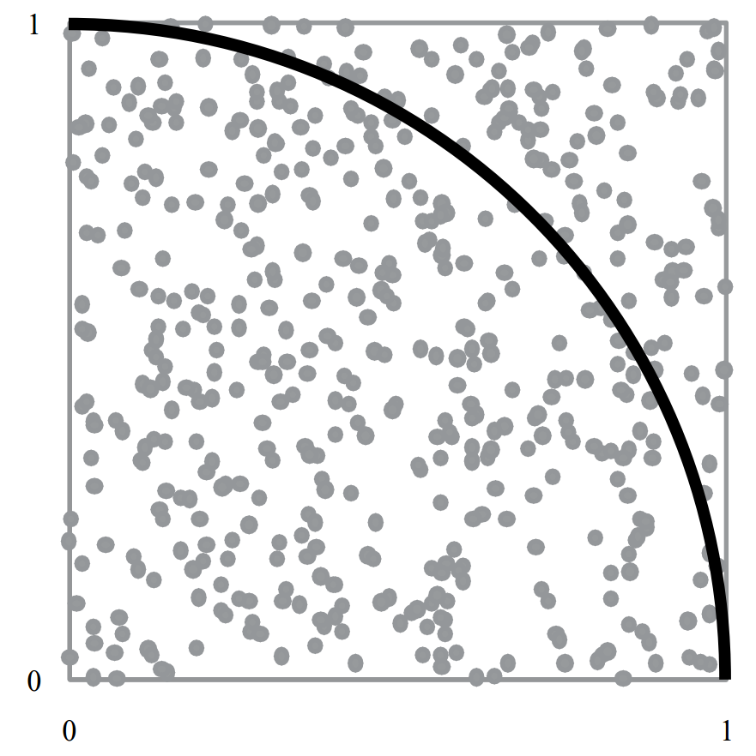
Calculating value of pi using Monte Carlo simulation
Step 2: Then, randomly choose an x and y coordinate inside the square, and place a dot at that location.

Slide 10
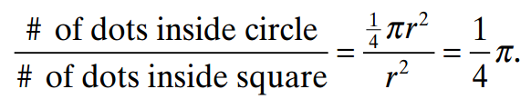
Calculating value of pi using Monte Carlo simulation
Step 3: Repeat step 2 at a given number of times.
Step 4: Count the total number of dots inside the square and the number of dots inside the quarter circle.
Step 5: With a large number of dots generated, these values will approximate the area of the circle and the area of the square.
From mathematics, this result can be represented as

Slide 11
Definition of Monte Carlo Simulation
Monte Carlo Simulation is this concept of repeated random samples of model input variables over many simulation runs .
When setting up a Monte Carlo simulation or employing the Monte Carlo Method, one follows a four - step process.
Step 1 Define a distribution of possible inputs for each input random variable.
Step 2 Generate inputs randomly from those distributions.
Step 3 Perform a deterministic computation using that set of inputs.
Step 4 Aggregate the results of the individual computations into the final result.

Slide 12
Step 1:
Step 1 Define a distribution of possible inputs for each input random variable.
Random variable is a variable whose values depend on outcomes of a random phenomenon.
For example: The outcome of a coin toss is a random variable with possible values of Head or Tail.
The distribution of these random numbers is a description of the portion of times each possible outcome or each possible range of outcomes occurs on the average over a great many trials.
Different distributions:
Uniform distribution Suppose a specified range is partitioned into intervals of the same length. With a uniform distribution, the generator is just as likely to return a value in any of the intervals.
Normal distribution
Exponential Distribution
Triangular Distribution etc.

Slide 13
Pseudorandom Numbers
Pseudorandom numbers are generated by computers.
They are not truly random, because when a computer is functioning correctly, nothing it does is random.
Computers

Slide 14
Applications of Pseudorandom Numbers
Pseudorandom numbers are essential to many computer applications, such as games and security. In games, random numbers provide unpredictable elements the player can respond to, such as dodging a random bullet or drawing a card from the top of a deck.
In computer security, pseudorandomness is important in encryption algorithms, which create codes that must not be predicted or guessed.

Slide 15
Pseudorandom number generator
A pseudorandom number generator, or PRNG, is any program, or function, which uses math to simulate randomness. It may also be called a DRNG (digital random number generator) or DRBG (deterministic random bit generator).
The math can sometimes be complex, but in general, using a PRNG requires only two steps:
Provide the PRNG with an arbitrary seed.
Ask for the next random number.
The seed value is a "starting point" for creating random numbers. The seed value is used when computing the numbers.
If the seed value changes, the generated numbers also change, and a single seed value always produce the same numbers. For this reason, the numbers aren't really random, because true randomness could never be re-created.
The current time is often used as a unique seed value. For instance, if it's March 5, 2018, at 5:03 P.M. and 7.01324 seconds UTC, that can be expressed as an integer. That precise time never occur again, so a PRNG with that seed should produce a unique set of random numbers.

Slide 16
Linear Congruential Method – A PRNG
In 1949, D. J. Lehmer presented one of the best techniques for generating uniformly distributed pseudorandom numbers, the linear congruential method.
One simple linear congruential random number generator that generates values between 0 and 10, inclusive, is as follows:
r₀ = 10
r_{n} = (7r_{n–1} + 1) mod 11, for n > 0
The initial value in the sequence of random numbers, r₀ = 10, is the seed. The mod function returns the remainder.
Thus, substituting r₀ = 10 on the right-hand side of the second line of the definition, the generating function, we calculate r₁ = (7 · 10 + 1) mod 11 = 5.
After we calculate one “random number,” to evaluate the next, we substitute that value into the expression on the right-hand side. Consequently, the next random number is r₂ = (7 · 5

Slide 17
Linear Congruential Method
The general form for the linear congruential method to generate pseudorandom integers from 0 up to, but not including, modulus is as follows:
r₀ = seed
r_{n} = (multiplier r_{n–1} + increment) mod modulus, for n > 0
where seed, modulus, and multiplier are positive integers and increment is a nonnegative

Slide 18
Random Floating-point Number generation
If we desire floating-point numbers between 0 and 1, we divide each number in the sequence by the modulus.
For this computation, the smallest possible pseudorandom floating-point number is 0.0 and the largest is (modulus – 1)/modulus. Thus, floating-point numbers that we generate by dividing by the modulus are in the interval [0.0, 1.0), or the interval between

Slide 19
Possible values for multiplier and modulus
Much research has been done to discover choices for multiplier and modulus that give the largest possible sequence that appears random.
For built-in random number generators, modulus is often the largest integer a computer can store, such as 2³¹ – 1 = 2,147,483,647 on some machines. For this modulus, a multiplier of 16,807 and an increment of 0 produce a sequence of 2³¹

Slide 20
Different Ranges of Random Numbers
The linear congruential method generated a random integer from 0 up to the modulus, where by up to we mean not including the modulus.
We can obtain a floating-point counterpart with value from 0.0 up to 1.0 by dividing by the modulus.
We can obtain uniformly distributed integer or real random numbers in any range.
Suppose that rand is a uniformly distributed random floating point number from 0.0 up to 1.0. Suppose, however, that we need a random floating point number from 0.0 up to 5.0. Because the length of this interval is 5.0, we multiply rand

Slide 21
Random numbers within any range
Mathematically, we have the following:
0.0 ≤ rand < 1.0
Thus, multiplying by 5.0 throughout, we obtain the correct interval, as shown:
0.0 ≤ 5.0 rand < 5.0
If the lower bound of the range is different from 0, we add that bound. For example, if we need a random floating-point number from 2.0 up to 7.0, we multiply by the length of the interval, 7.0 – 2.0 = 5.0, to expand the range. Then, we add the lower bound, 2.0, to shift, or translate, the result so that the following inequalities hold:
2.0 ≤ (7.0 – 2.0) rand + 2.0 < 7.0
or
2.0 ≤ 5.0 rand

Slide 22
Specifying Random Floating-Point Numbers in Other Ranges
If rand is a random floating-point number such that 0.0 ≤ rand < 1.0, then (max – min)rand + min is a random floating-point number from min up to max that satisfies the following inequality:
min ≤ (max – min) rand + min < max

Slide 23
Random Integer numbers upto the modulus
Frequently, we need a more-restricted range of random integers than from 0 up to modulus.
For example, a simulation might require random integer temperatures between 0 and 99, inclusive.
One method of restricting the range is to multiply a floating-point random number between 0.0 and 1.0 by 100 (the number of integers from 0 through 99, or 99 + 1) and then return the integer part (the number before the decimal point). For example, suppose rand is 0.692871. Multiplying by 100, we obtain 100 · 0.692871 = 69.2871. Truncating, we obtain an integer (69) between 0 and

Slide 24
Random Integer numbers with lower bound other than 0
Sometimes we want the range of random integers to have a lower bound other than 0, for example, from 100 to 500, inclusive. Because we include 100 and 500 as options, the number of integers from 100 to 500 is one more than the difference in these values, (500 – 100 + 1) = 401.
As with the last example, we multiply this value by rand to expand the range. Then, we add the lower bound, 100, to the product to translate the range to start at 100 as follows:
100.0 ≤ 401rand

Slide 25
Random Integer numbers upto the modulus with lower bound other than 0
Finally, we take the integer part of the result, which we write here as applying a function INT.
100 ≤ INT(401rand + 100) < 501
or
100 ≤ INT(401rand + 100) ≤ 500
Because the floating-point numbers (401rand + 100) are less than 501.0, after truncation, the

Slide 26
Specifying Random Integers in Other Ranges
If rand is a random floating-point number such that 0.0 ≤ rand < 1.0, then INT((max – min + 1)rand + min) is a random integer from min to max, inclusive, that satisfies the following inequality:
min ≤ INT( (max – min + 1)·rand + min) ≤ max

Slide 27
Random Numbers from Various Distributions
A Monte Carlo simulation requires the use of unbiased random numbers.
The distribution of these numbers is a description of the portion of times each possible outcome or each possible range of outcomes occurs on the average over a great many trials.
However, the distribution that a simulation requires depends on the problem. There are algorithms for generating random numbers from

Slide 28
Uniform Distribution
Suppose a specified range is partitioned into intervals of the same length. With a uniform distribution, the generator is just as likely to return a value in any of the intervals.
Equivalently, in a list of many such random numbers, on the average each interval contains the same number

Slide 29
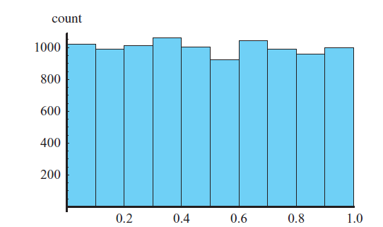
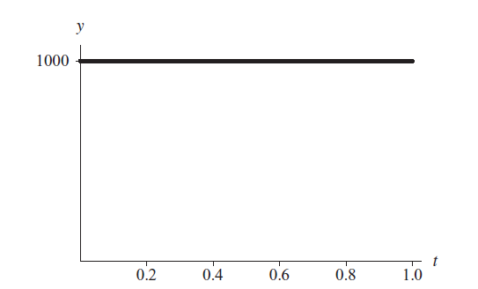
Uniform Distribution
For example, figure on the left presents a histogram with 10 intervals of length 0.1 of a table of 10,000 random floating-point numbers, uniformly distributed from 0.0 up to 1.0.
As expected, approximately one-tenth of the 10,000, or 1000, numbers appears in each subdivision. Thus, the curve across the tops of the bars is virtually a horizontal line of height 1000.
Fig. 3: Histogram of 10,000 random floating-point numbers, uniformly distributed from 0.0 up to 1.0
Fig. 4: Horizontal line at height 1000 approximately goes across the top of the histogram

Slide 30
Discrete and Continuous Distribution
A distribution can be discrete or continuous.
A discrete distribution is a distribution with discrete values. A continuous distribution is a distribution with continuous values.
Discrete data can only take certain values.
Continuous data can take any value (within a range).
To illustrate the difference between the terms discrete and continuous, a digital clock shows time in a discrete manner, from one minute to the next, while a clock with two hands indicates time in a continuous, unbroken

Slide 31
Probability Density Function
For a discrete distribution, a probability function (or density function, or probability density function) returns the probability of occurrence of a particular argument value.
For example, P(1382) might be the probability that the random number generator returns 1382.
However, if a distribution is continuous, the probability of occurrence of any particular value is zero. Thus, for a continuous distribution, a probability function (or density function, or probability density function) indicates the probability that a given outcome falls inside a specific range of

Slide 32
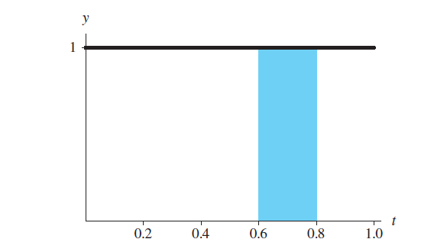
Probability Density Function
The integral of the probability function from the lower to the upper bound of the range, which is the area under that portion of the curve, gives the probability that the outcome is in that range.
For example, the probability that the random velocity in the x-direction of a dust particle is between 3.0 and 4.0 mm/s is the integral of the probability density function from 3.0 to 4.0.
Figure presents a horizontal line of height 1 that is the graph of the probability density function (P(x) = 1) for uniformly generated random numbers with values from 0.0 up to 1.0.
The probability that a uniform random floating-point number between 0.0 and 1.0 falls between 0.6 and 0.8 is the integral of the function f(x) = 1 from 0.6 to 0.8. Thus, the probability is the area of the shaded region between 0.6 and 0.8, which is (0.8 – 0.6) (1.0) = 0.2. Such a random number is between 0.6 and 0.8 for 0.2 = 20% of the time.
Fig. 5: Probability density function for the distribution with histogram in Fig. 3

Slide 33
Discrete Distributions with equal probability of all events
If an equal likelihood of each of several discrete events exists, in a simulation we can generate a random integer to indicate the choice.
For example, in a simulation of a pollen grain moving in a fluid, suppose at the next time step the grain is just as likely to move in any direction—north, east, south, west, up, or down—in a three-dimensional (3D) grid.
A probability of 1/6 exists for the grain to move in any of the six directions.
With these equal probabilities, we can generate a uniformly distributed integer between 1 and 6 to indicate the direction of movement.
Thus to simulate discrete distributions where every event has equal chance to exist, generate a uniform random integer from a sequence of n integers, where each integer corresponds to an event.

Slide 34
Discrete Distributions with varying probability of events
Frequently, however, the discrete choices do not carry equal probabilities.
For example, in an initial 3D grid, suppose only 15% of the grid sites, or cells, contain pollen grains. Thus, a probPollen = 15% = 0.15 chance exists for a cell to contain a grain.
If the location is to contain a pollen grain, we make the cell’s value equal to POLLEN = 1; otherwise, the cell’s value becomes EMPTY = 0.
To initialize a grid for a simulation, we must designate for each cell if the location contains pollen or not.
For each cell, we need to generate a uniformly distributed random floating-point number from 0.0 up to 1.0. On the average, 15% of the time this random number is less than 0.15, while 85% of the time the number is greater than or equal to 0.15.
Thus, to initialize the cell, if the random number is less than 0.15, we make the cell’s value POLLEN; otherwise, we assign EMPTY to the cell’s value.

Slide 35
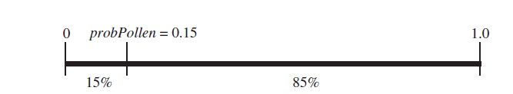
Discrete Distributions with varying probability of events
Using the probabilities and cell values, employ the following logic is employed to initialize each cell in the grid:
if a random number is less than probPollen (i.e., pollen grain at site)
set the cell’s value to POLLEN
else (i.e., no pollen grain at site)
set the cell’s value to EMPTY
Fig: 15% of floating-point values between 0 and 1 are less than probPollen = 0.15

Slide 36
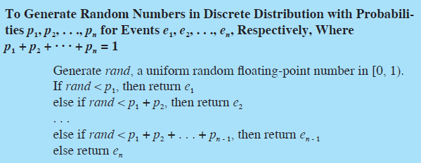
Discrete Simulations with varying probabilities

Slide 37

Normal Distribution
A normal, or Gaussian, distribution, which statistics frequently employs, has a probability density function where μ is the mean and σ is the standard deviation of the form .

Slide 38
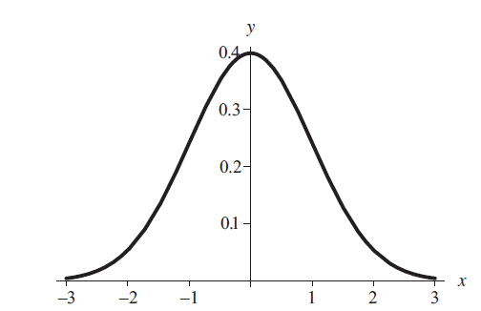
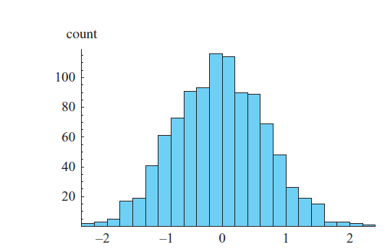
Normal Distribution
Below figure displays a histogram of a set of 1000 random numbers in the Gaussian distribution with mean 0 and standard deviation 1.
68.3% of the values in a normal distribution are within ±σ of the mean, μ; 95.5% are within ±2σ of μ; and 99.7% are within ±3σ of μ.
Fig: Probability density function for normal distribution
with mean 0 and standard deviation 1
Fig: Histogram of a normal distribution with mean 0 and standard deviation 1

Slide 39
Generating Random Numbers in Normal Distribution
The Box-Muller-Gauss method can be employed to generate numbers in a normal distribution.
The method first generates a uniformly distributed random number, a, between 0 and 2π.
Then, the technique computes b, the product of the standard deviation (σ) and the square root of the negative natural logarithm of a uniformly distributed random number between 0.0 and 1.0.

Slide 40
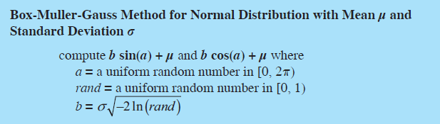
Box-Muller-Gauss method
The two values b · sin(a) + μ and b · cos(a) + μ are normally distributed with mean μ and standard deviation σ.

Slide 41
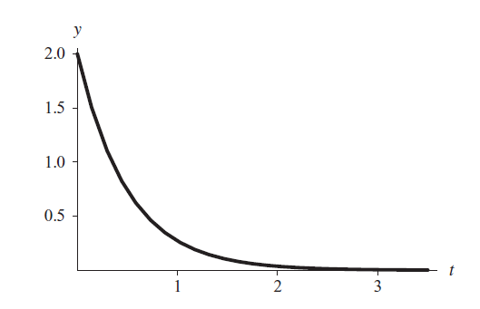
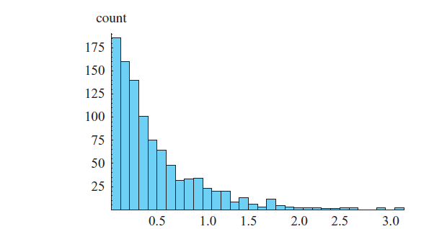
Exponential Distribution
Functions of the form f(t) = |r|e^{rt} with r < 0 and t > 0, or f(t) = |r|e^{rt} with r > 0 and t < 0 are probability density functions in which the area under each curve is 1.
Figure on the left contains the graph of a function in this category, f(t) = 2e–2t. Figure on the right displays a histogram of 1000 such exponentially distributed random numbers.
Fig. Histogram of 1000 random numbers ln(rand)/(–2), where rand is a uniformly generated random number in [0.0, 1.0)
Fig. Probability density function f(t) = 2e–2t for t > 0

Slide 42
Generating Random Numbers in Normal Distribution
To obtain a number in such a distribution, the exponential method divides the natural logarithm of a uniformly distributed random number from 0.0 to 1.0 by the rate constant (r), that is, ln(rand)/r, where rand is random between 0 and 1.
For example, to generate numbers in the distribution f(t) = 2e^{–2t}, we calculate ln(rand)/(–2).

Slide 43
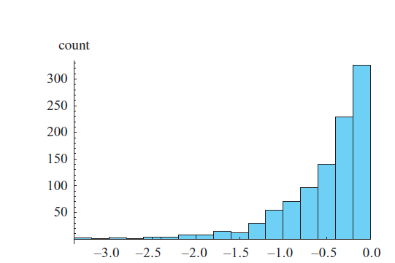
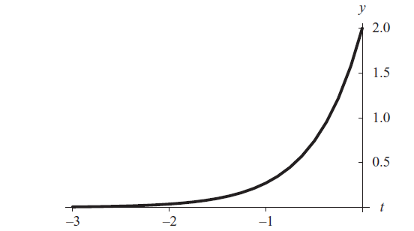
Generating Random Numbers in Exponential Distribution
The same algorithm is employed to generate random numbers from minus infinity to 0 for probability density function f(t) = |r|e^{rt} = re^{rt} with r > 0.
Figure on the left shows the graph of one such function, f(t) = 2e^{2t}; and Figure on the right displays a histogram of 1000 pseudorandom numbers that the algorithm ln(rand)/2 generates.
Fig: Histogram of 1000 numbers ln(rand)/2, where rand is a uniformly generated random number in [0.0, 1.0)
Fig: Probability density function f(t) = 2e2t for t < 0

Slide 44
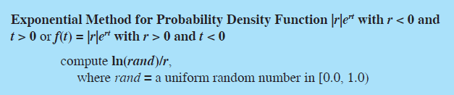
Probability density function for Exponential Distribution

Slide 45
Step 1:
If this distribution is known or sufficient data exist to derive it, then this step is straightforward.
However, if the behavior of an input variable is not well understood, then the modeler might have to estimate this distribution based on empirical observation or subject matter expertise.
The modeler may also use a uniform distribution if he or she is lacking any specific knowledge of the variable ’ s characteristics.
When additional information is gathered to define the variable, then the uniform distribution can be replaced.

Slide 46
Step 2:
Step 2 Generate inputs randomly from those distributions.
Step 2 requires randomly sampling each input variable ’ s distribution many times to develop a vector of inputs for each variable.
Suppose we have two input random variables X and Z.
After sampling n times, we have X = (x₁, x₂,… , x_{n}) and Z = (z₁, z₂, … , z_{n}).
Elements from these vectors are then sequentially chosen as inputs to the function defining the model.
The question of how large n should be is an important one because the number of samples determines the power of the output test statistic.
As the number of samples increases, the standard deviation of the test statistic decreases.
In other words, there is less variance in the output with larger sample sizes.
However, the increase in power is not linear with the number of samples so there is a point when more sampling provides little improvement.

Slide 47
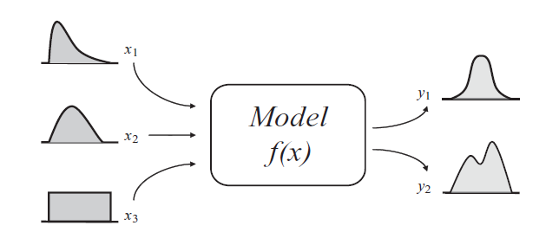
Basic Monte Carlo Model

Slide 48
Steps 3 and 4
Step 3 is straightforward. It involves sequentially choosing elements from the randomly generated input vectors and computing the value of the output variable or variables until all n outputs are generated for each output variable.
Step 4 involves aggregating all these outputs. Suppose we have one output variable Y. Then we would have as a result of step 4 an output vector Y = (y1,y2, … , yn).
We can then perform a variety of statistical tests on Y to analyze this output.

Slide 49
Components in Monte Carlo Simulation
This four - step method requires having the necessary components in place to achieve the final result. These components may include:
(1) probability distribution functions (pdfs) for each random variable.
(2) a random number generator
(3) a sampling rule— a prescription for sampling from the pdfs
(4) scoring— a method for combining the results of each run into the final result
(5) error estimation— an estimate of the statistical error of the simulation
output as a function of the number of simulation runs and other
parameters.

Slide 50


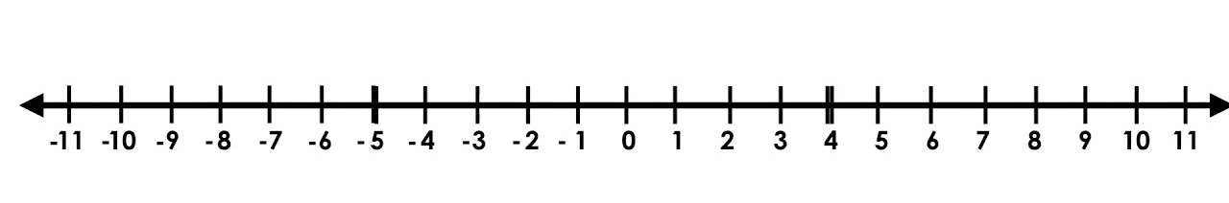
Random Walk along an Integer Line (1D Random Walk)
+1
-1
P(+1) = 1/2
P(-1) = 1/2

Slide 51
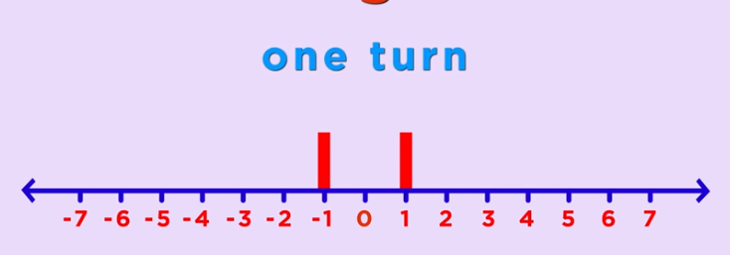
Random Walk along an Integer Line (1D Random Walk)
P(-1)=1/2
P(1)=1/2

Slide 52
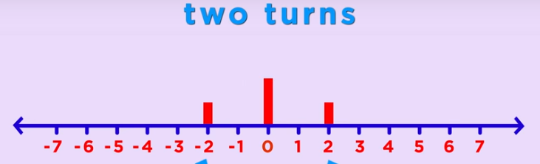
Random Walk along an Integer Line (1D Random Walk)
P(-2)=1/4
P(2)=1/4
P(0)=1/2

Slide 53
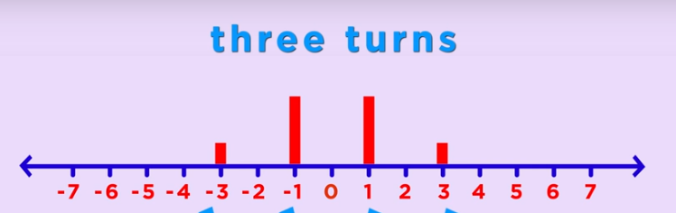
Random Walk along an Integer Line (1D Random Walk)

Slide 54
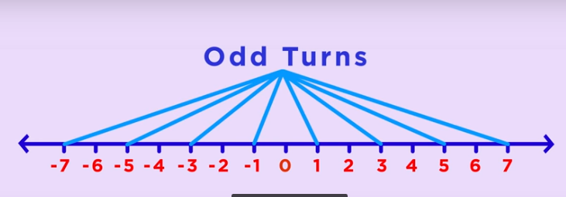
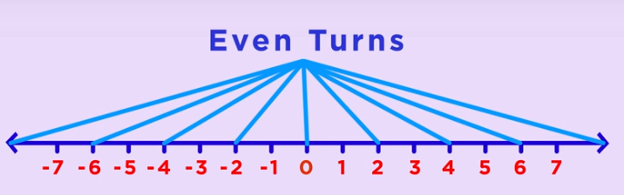
Random Walk along an Integer Line (1D Random Walk)

Slide 55
Probability at different points of integer line in successive coin flips
 | -8 | -7 | -6 | -5 | -4 | -3 | -2 | -1 | 0 | 1 | 2 | 3 | 4 | 5 | 6 | 7 | 8
1st |  |  |  |  |  |  |  | 1/2 |  | 1/2
2nd |  |  |  |  |  |  | 1/4 |  | 1/2 |  | 1/4
3rd |  |  |  |  |  | 1/8 |  | 3/8 |  | 3/8 |  | 1/8
4th |  |  |  |  | 1/16 |  | 1/4 |  | 3/8 |  | 1/4 |  | 1/16
5th |  |  |  | 1/32 |  | 5/32 |  | 5/16 |  | 5/16 |  | 5/32 |  | 1/32
6th |  |  | 1/64 |  | 3/32 |  | 15/64 |  | 5/16 |  | 15/64 |  | 3/32 |  | 1/64
7th |  | 1/128 |  | 7/128 |  | 21/128 |  | 35/128 |  | 35/128 |  | 21/128 |  | 7/128 |  | 1/128
8th | 1/256 |  | 4/128 |  | 7/44 |  | 7/32 |  | 35/128 |  | 7/32 |  | 7/44 |  | 4/128 |  | 1/256
9th

Slide 56
Analysis of the 1D Random Walk
For N coin flips, we’ll most probably be between √N and - √N.
Remember the sailors story?
Let F_{i} denote the outcome of the i^{th} coin flip.
F_{i} is a random variable with equal probability assigned to its two different values +1 and -1.
Let S_{n} denote the location on the integer line after N flips. It’s also a random variable.
S_{n} = F₁+F₂+F₃+….+F

Slide 57
Analysis of the 1D Random Walk
The expected value of F_{i} is (1/2)(+1)+(1/2)(-1)=0
The expected value of S_{n} is the sum of all the expected values of F_{i} i.e. 0.
Over many Random walks, the average of your location will be 0.

Slide 58
Random Walk in 2D
The same holds true for Random Walk in 2D. The entity returns to its starting location multiple times during the walk.
This answers George Polya’s question of “What are the chances of two randomly walking couple bumping into each other?”.

Slide 59
Types of Random Walk
Recurrent walk is the random walk where there is 100% probability of returning to the starting point.
Random walk in 1D and 2D are recurrent random walks.
Transient Random Walk is the random walk in which there is a positive probability that it never returns to its starting .
Random walk in 3D or higher dimensions is transient random walk.
A drunk man will finally find his way back to his home but a drunk bird will be lost forever.

Slide 60
Simple (and not so Simple) Random Walk
What we have seen in 1D Random walk along the integer line is a Simple Random Walk because in Simple Random Walk, we have equal probabilities of moving in each direction.
These probabilities can be different but then it won’t be a simple random walk.
Suppose the probability of moving towards right is p = 3/4, then the probability of moving towards the left is 1 - p = 1/4

Slide 61
Random Walks with different Probabilities
Let p be the probability of moving towards right then the probability of moving towards left will be 1-p,
The expected value of F_{i} is then (p)(+1)+(1-p)(-1) = 2p - 1
The expected value of S_{n} is nFi = n(2p-1)
So your average location after many random walks with the given probabilities will be n(2p-1).
Suppose p=3/4.
For n= 10, S_{n}= 5
For n=100, S_{n}=50

